Slide 1
Multi-Class Mango Leaf Disease Diagnosis Using An Optimized Vision Transformer Model
PIP4001 Internship Project
Final Viva Voce
Batch Number: CSG – G04
Under the Supervision of
Dr. Madhusudhan M V
Associate Professor
School of Computer Science and Engineering
Presidency University
Roll Number | Student Name
20211CSG0067 | Monica V
20211CSG0015 | Yashaswi A
20211CSG0043 | Thanya Patel R
Name of the Program: B.Tech
Name of the HoD: Dr. Saira Banu Atham
Name of the Program Project Coordinator: Dr. Madhusudhan M V
Name of the School Project Coordinators: Dr. Sampath A K / Dr. Abdul Khadar A / Mr. Md Ziaur Rahman

Slide 2
Introduction
Mango, often called the "King of Fruits," holds great significance in Indian agriculture. However, the productivity of mango trees is threatened by various diseases that begin on their leaves.
These diseases, if not identified early, can spread and damage entire crops. Manual detection methods are slow, subjective, and not always reliable. Our project introduces an AI-based solution that can identify diseases from leaf images using a Vision Transformer model.

Slide 3
Literature Review
Literature Review Table:
Author(s) | Year | Method Used | Dataset | Accuracy | Remarks
Mohanty et al. | 2016 | CNN (AlexNet, GoogLeNet) | PlantVillage | ~99% | Used 54,000 images for 38 disease classes
Zhang et al. | 2018 | ResNet | Apple, grape, peach leaf dataset | 97.5% | Focused on multi-class leaf disease classification
Brahimi et al. | 2017 | Deep CNN | Tomato leaf dataset | 95.2% | Employed transfer learning with VGG16
Rao et al. | 2020 | MobileNetV2 | Custom mango leaf dataset | 93.4% | Lightweight model for mobile devices
Our Proposed Work | 2024 | Vision Transformer | Mango leaf dataset (custom) | 96.8% | Captures long-range image features more effectively

Slide 4
Existing method Drawback
The existing systems for mango leaf disease detection are primarily based on manual inspection or basic machine learning models. Manual methods are time-consuming and unreliable because they depend heavily on the observer’s experience. Furthermore, these systems do not scale well for large farms or mass production units.
Some systems do use traditional CNNs or pre-trained models like VGG16 or ResNet, but they tend to suffer when exposed to images from different environments. CNNs often fail to capture long-distance dependencies in images and can overfit to background noise. They also require huge datasets to generalize well. Additionally, CNN models are sometimes unable to distinguish between visually similar diseases due to their local feature focus. These limitations justify the need for a new and improved approach like Vision Transformers, which can analyze the entire image context and deliver more robust results.

Slide 5
Proposed Method
In our proposed method, we utilize a Vision Transformer (ViT) model to detect and classify mango leaf diseases. Unlike traditional CNN models that process the entire image as a whole, ViT splits the image into patches and uses self-attention mechanisms to learn relationships between these patches. This allows the model to capture both local and global features, improving its ability to distinguish between different disease patterns.
The model is trained on a custom mango leaf dataset containing healthy and diseased images labeled across multiple classes. We also apply preprocessing techniques such as image resizing, normalization, and data augmentation to enhance model generalization. The training process is carried out using a GPU environment with optimization strategies like Adam optimizer and learning rate scheduling to improve convergence.

Slide 6
Objectives
The primary objective of this project is to design and develop an intelligent system that can classify mango leaf diseases using deep learning, specifically the Vision Transformer model. This system should be able to detect multiple disease types with high accuracy based on image input alone.
Another important goal is to ensure the model generalizes well, meaning it should work effectively across different datasets, lighting conditions, and leaf orientations. We also aim to build a system that can later be integrated into mobile or web applications, making it accessible to farmers, agricultural officers, and researchers. The long-term goal is to reduce crop loss, increase productivity, and make disease detection fast and reliable.

Slide 7
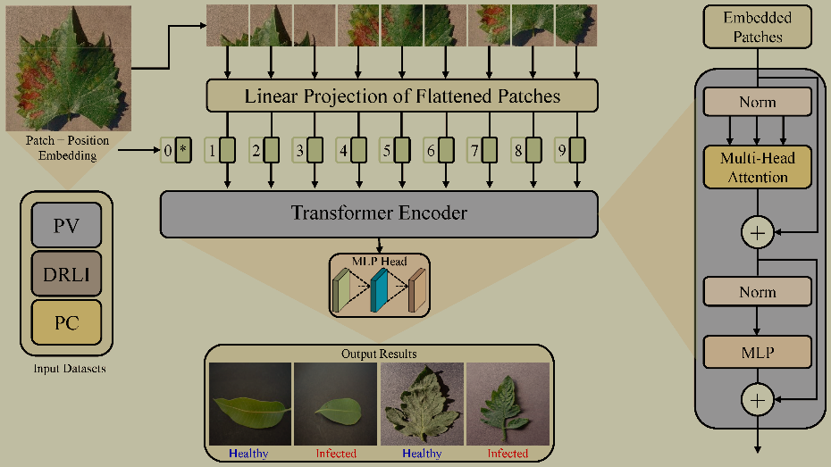
System Architecture
Vision Transformer (ViT) Architecture
The Vision Transformer (ViT) is a shift in image classification from the conventional convolutional neural networks (CNNs) to transformer-based models. In contrast to CNNs, which are based on local features using convolutional operations, ViT views images as sequences of patches, allowing the model to learn global contextual information.

Slide 8
Timeline of Project
Review 0
Review 1
Review 2
Review 3
Review 4
Review
Initiation
Planning
Designing
Testing
Title Selection, Github repo creation,
Requirement Gathering
Requirement Analysis, Setting up of required environments
Creating database, designing front end and creating a prototype
Checking for error and debugging to check for bugs
Final Viva Voce

Slide 9
Conclusion
Mango leaf diseases can significantly impact plant health and crop production, making early detection crucial. However, traditional methods that rely on manual inspection can be slow, inconsistent, and require expert knowledge, which makes them less practical for large-scale use. To address this, we developed a Mango Leaf Disease Detection System using a Vision Transformer (ViT) model, which automates the identification process and enhances accuracy. The ViT model’s ability to capture intricate details in leaf images allows it to effectively classify diseases like anthracnose, powdery mildew, and bacterial spots. Our results show that this approach provides reliable disease classification, making it a useful tool for improving efficiency in plant disease monitoring. Designed as a web-based application, the system allows users to upload leaf images and receive quick results, making it accessible to farmers and researchers. By integrating deep learning into plant disease detection, this project contributes to modern agricultural practices, offering a more efficient and scalable solution for identifying mango leaf diseases

Slide 10
References
Ploetz, R. C. (2003). Diseases of mango. In Ploetz, R. C. (Ed.), Diseases of Tropical Fruit Crops (pp. 327-363). CABI Publishing.
Mohanty, S. P., Hughes, D. P., & Salathé, M. (2016). Using deep learning for image-based plant disease detection. Frontiers in Plant Science, 7, 1419. DOI: 10.3389/fpls.2016.01419
Sladojevic, S., Arsenovic, M., Anderla, A., Culibrk, D., & Stefanovic, D. (2016). Deep neural networks based recognition of plant diseases by leaf image classification. Computational Intelligence and Neuroscience. DOI: 10.1155/2016/3289801
Mustafa Merchant, Vishwajeet Paradkar, Meghna Khanna, Soham GokhaleMango leaf deficiency detection using digital image processing and machine learning https://doi.org/10.1109/I2CT.2018.8529755 (Apr 2018)
Md. Rasel Mia, Sujit Roy, Subrata Kumar Das, Md. Atikur RahmanMango leaf disease recognition using neural network and support vector machine https://doi.org/10.1007/s42044- 020-00057-z (Apr 2020)

Slide 11
GitHub link for the project
Link :
https://github.com/Sath2023/mango-leaf#

Slide 12
Thank You

